Slide 1
Analysis & Prediction of CPU Performance Data
Balaji Sri Raj
MS Analytics, MBA, MS Psychology

Slide 2
About the Dataset - Relative CPU Performance Data
Number of Instances: 209
Number of Attributes: 10 (6 predictive attributes, 2 non-predictive, 1 goal field, 1 guess field)
Model Name: many unique symbol
MYCT: machine cycle time in nanoseconds (integer)
MMIN: minimum main memory in kilobytes (integer)
MMAX: maximum main memory in kilobytes (integer)
CACH: cache memory in kilobytes (integer)
CHMIN: minimum channels in units (integer)
CHMAX: maximum channels in units (integer)
PRP: published relative performance (integer)
ERP: estimated relative performance from the original article (integer)
Missing Attribute Values: None
Class field: PRP
Guess field: ERP

Slide 3
Problem Statement
The aim of this analysis is to understand the dependency of PRP, relative performance of CPU based on the given features.
Predicting the y variable (PRP) keeping the rest variables as dependent variable.

Slide 4
Analysis Methodology
EDA – Exploratory data Analysis
Data cleaning & Transformation
Feature Engineering
Selecting the right model
Prediction of Y variable
Cross Validation & Iteration
Road map for future

Slide 5
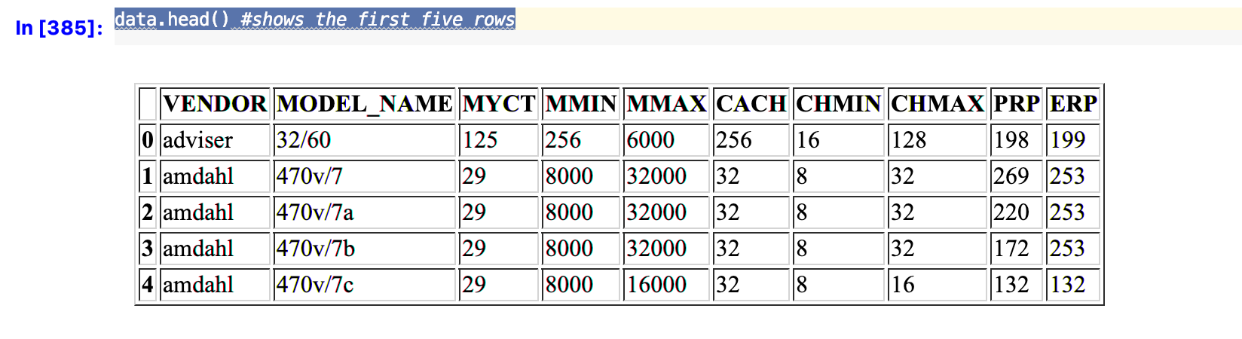
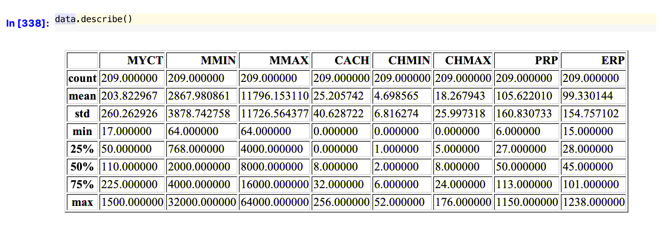
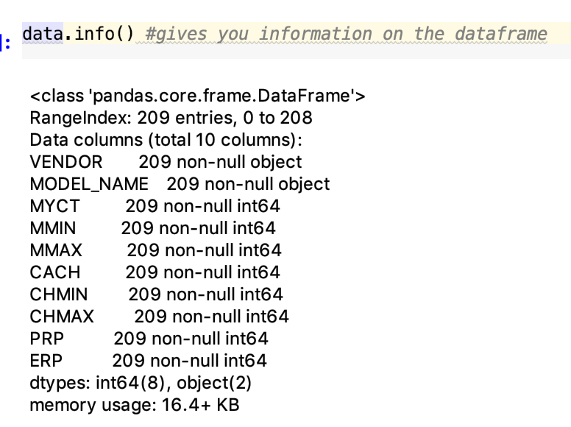
EDA – Exploratory Data Analysis
Points to note:
No missing values
Total Columns – 10, 2 – Categorical, 8 – Numerical
Values at 25%,50%,75%,Mean, Std shows there is a very high chance the data is skewed.

Slide 6
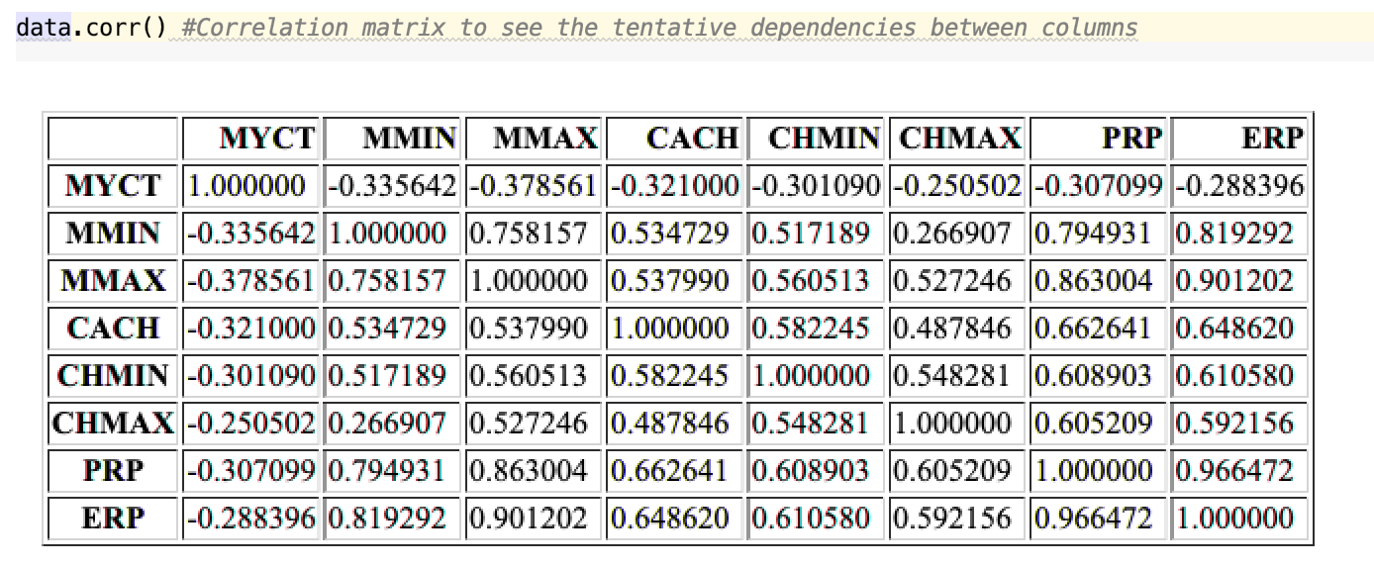
EDA – Exploratory Data Analysis
Correlation Analysis helps us determine the relationship between variables. Here we can see that there seems to be a moderate positive correlation between the features & PRP.
Note: Correlation does not mean causation.

Slide 7
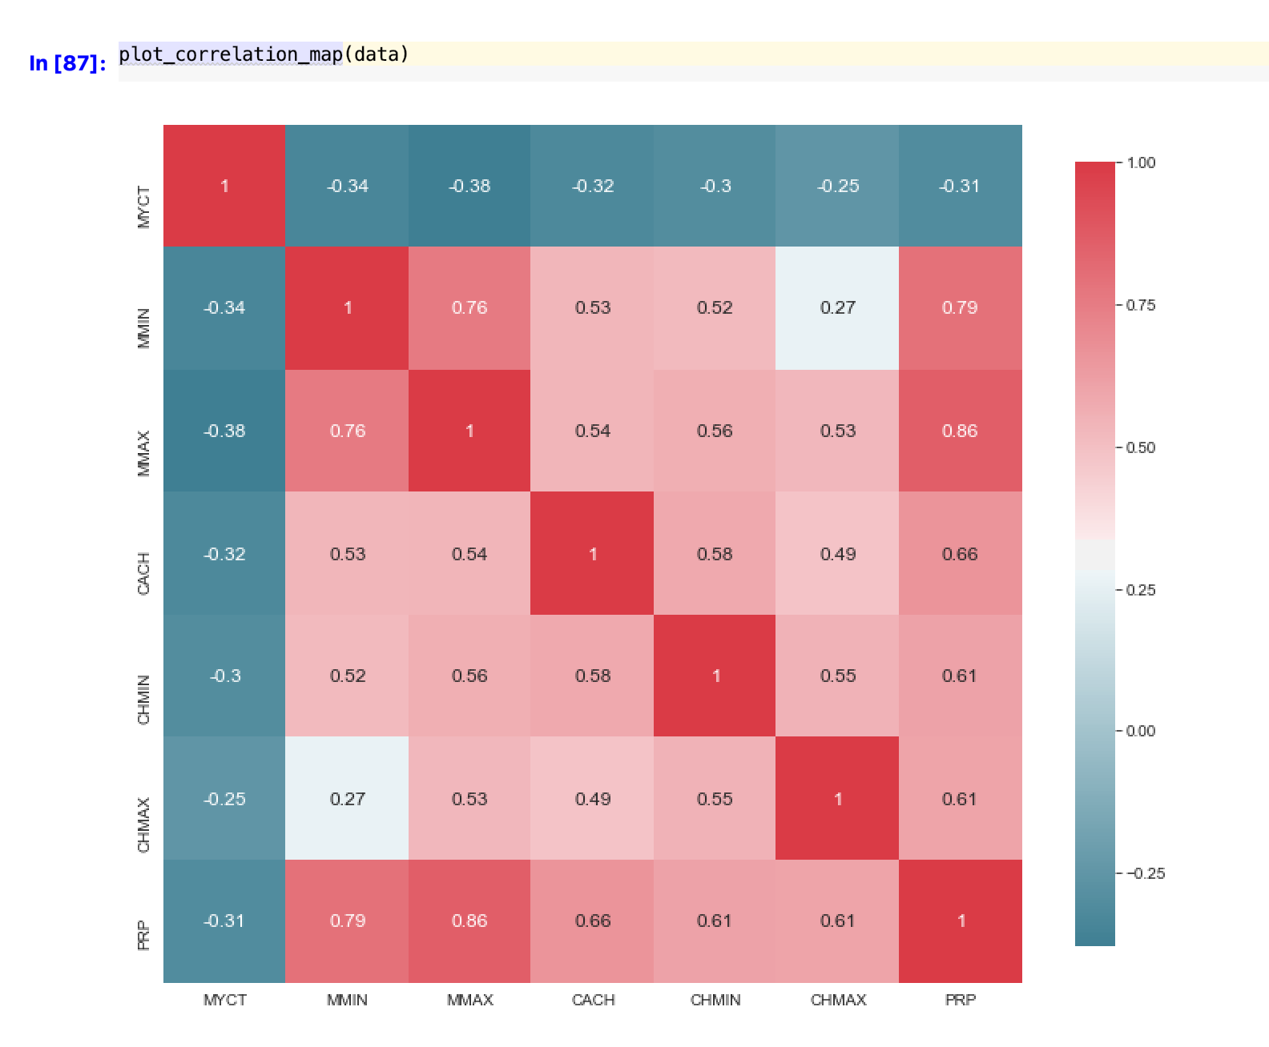
EDA – Exploratory Data Analysis
PRP & MMAX is highly positively correlated, that is 86%.
MMIN is positively correlated that is up to 79%.
The lowest are CHMIN & CHMAX that is around 61%.

Slide 8
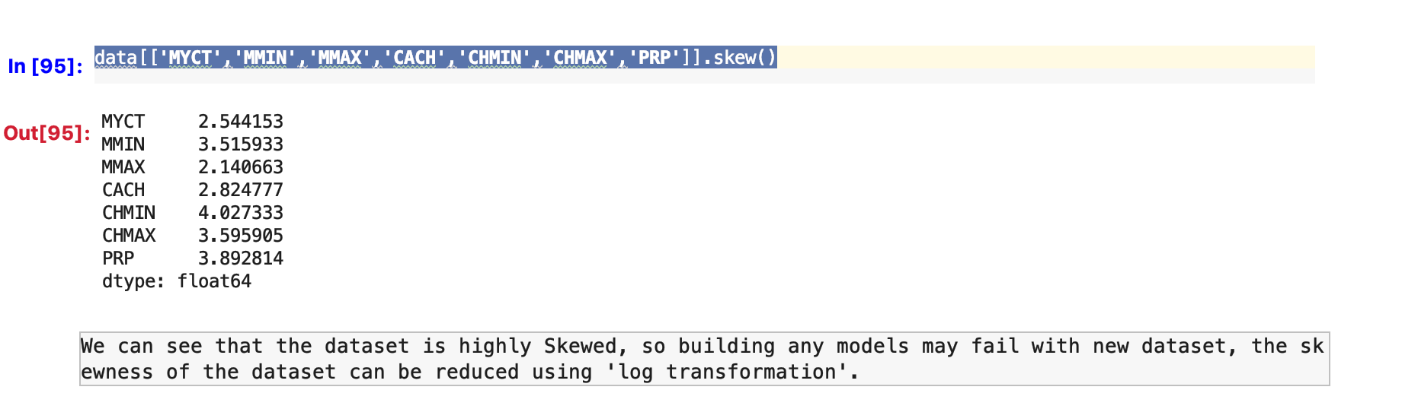
Checking for Skewness
We can see here that as suspected the data is highly skewed since all the features are >1.
An optimal value for skewness would be -0.5 to 0.5 for any normally distributed data.
How to correct Skewness?
There are multiple methods to correct skewness, here we can do logarithmic transformation, but there is a catch,
because for logarithmic transformation the values should not be negative or zero. But in our data we can see that we do
have values <= 0.

Slide 9
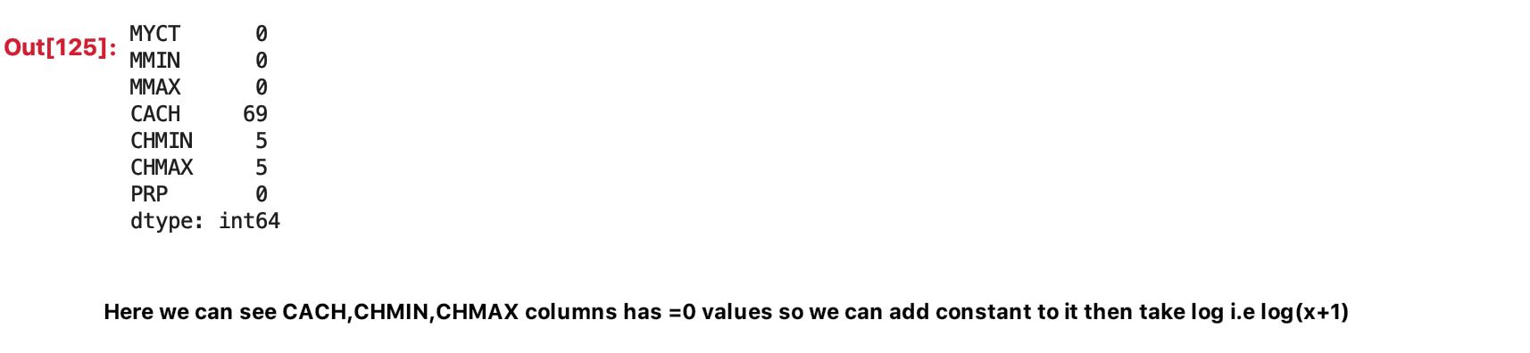
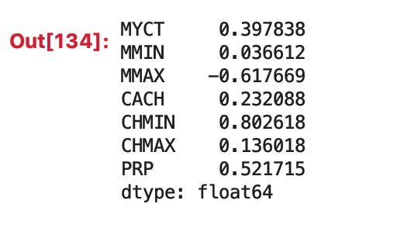
Logarithmic Transformation
Variables CACH, CHMIN, CHMAX are having values <=0.
To do logarithmic transformation, a constant value has to be introduced in this case.
log(x + constant), here we have taken 1 as our constant since we don’t have any negative values.
3) Below we can see after log transform the skewness has been reduced.

Slide 10
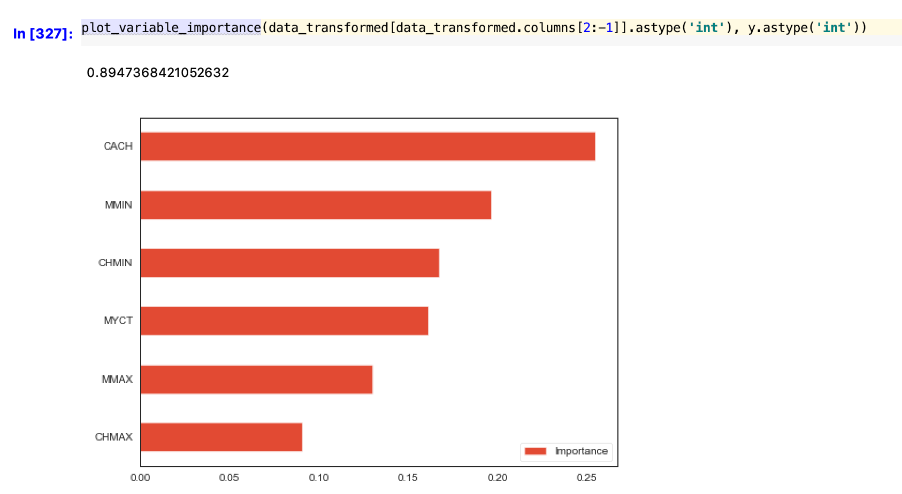
Variable Importance & Feature Engineering
Creating Dummies since not all ML algorithms support
categorical data.
2) Creating dummies may not be a good idea if our categorical
variable has too many unique values, but in our case it is fine.

Slide 11
Modelling & Prediction
Modelling Algorithms used:
Random Forest
Lm
Gradient Boosting
ADA boost Regressor
Bagging Regressor

Slide 12
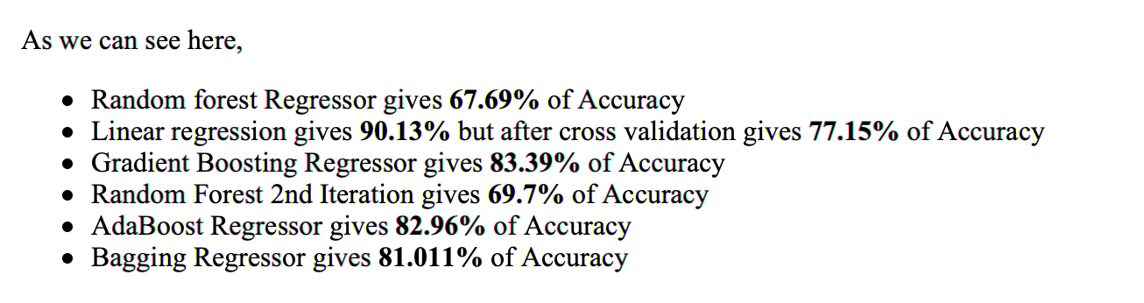
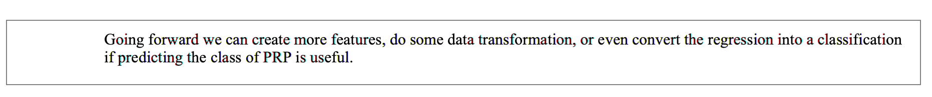
Results & Recommendation
Ipython Notebook file has been attached with the email.

